Slide 1
My Measurement and Ratio Interactive Notebook
Name
Class
Term 3 Semester 2

Slide 2
Contents
Formula Page
Page
Date
Description
2
3

Slide 3
Tasks
24
7
30
Essential Question
Questions
Notes
Summary
12
13

Slide 4
Write down 5 ratios equivalent to 5:1

Slide 5
24
7
30
Date
Simplifying Ratio
EQ – How do I simplify ratios with fractions and different units
11

Slide 6
24
7
30
Date
Simplifying Ratio
EQ – How do I simplify ratios with fractions and different units
To simplify a ratio divide the values by the HCF of the values.
e.g. Simplify
15 : 5
11

Slide 7
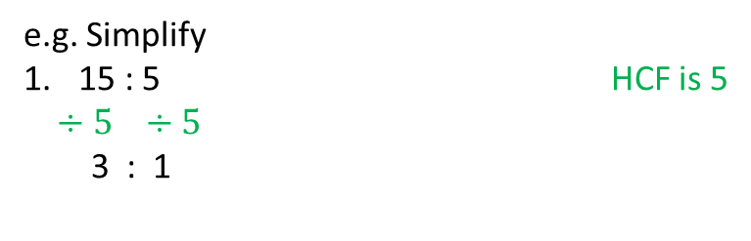
24
7
30
Date
Simplifying Ratio
EQ – How do I simplify ratios with fractions and different units
To simplify a ratio divide the values by the HCF of the values.
e.g. Simplify
15 : 5 HCF is 5
$÷5 ÷5$
3 : 1
11

Slide 8
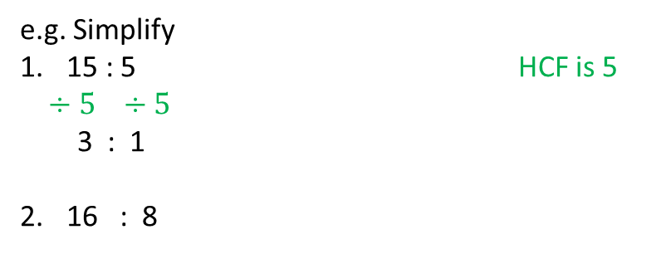
24
7
30
Date
Simplifying Ratio
EQ – How do I simplify ratios with fractions and different units
To simplify a ratio divide the values by the HCF of the values.
e.g. Simplify
15 : 5 HCF is 5
$÷5 ÷5$
3 : 1
16 : 8
11

Slide 9

24
7
30
Date
Simplifying Ratio
EQ – How do I simplify ratios with fractions and different units
To simplify a ratio divide the values by the HCF of the values.
e.g. Simplify
15 : 5 HCF is 5
$÷5 ÷5$
3 : 1
16 : 8 HCF is 8
$÷8 ÷8$
2 : 1
11

Slide 10
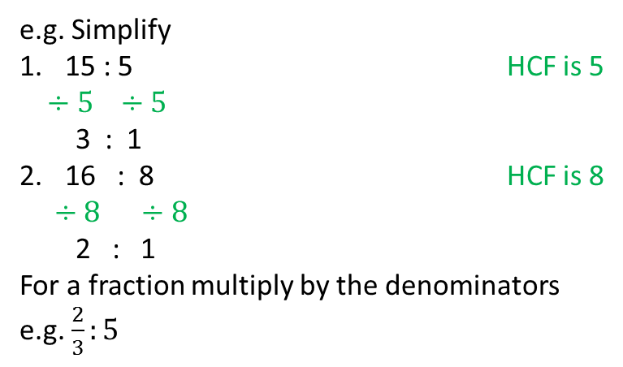
24
7
30
Date
Simplifying Ratio
EQ – How do I simplify ratios with fractions and different units
To simplify a ratio divide the values by the HCF of the values.
e.g. Simplify
15 : 5 HCF is 5
$÷5 ÷5$
3 : 1
16 : 8 HCF is 8
$÷8 ÷8$
2 : 1
For a fraction multiply by the denominators
e.g. $\frac{2}{3}:5$
11

Slide 11
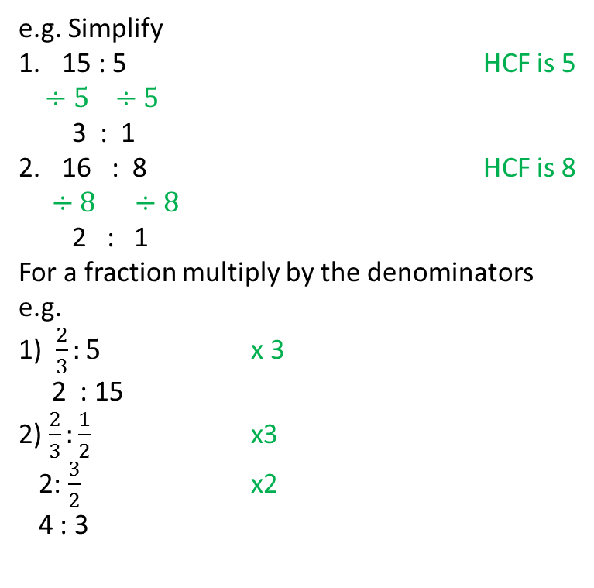
24
7
30
Date
Simplifying Ratio
EQ – How do I simplify ratios with fractions and different units
To simplify a ratio divide the values by the HCF of the values.
e.g. Simplify
15 : 5 HCF is 5
$÷5 ÷5$
3 : 1
16 : 8 HCF is 8
$÷8 ÷8$
2 : 1
For a fraction multiply by the denominators
e.g.
1) $\frac{2}{3}:5$ x 3
2 : 15
2) $\frac{2}{3}:\frac{1}{2}$ x3
2: $\frac{3}{2}$ x2
4 : 3
11

Slide 12
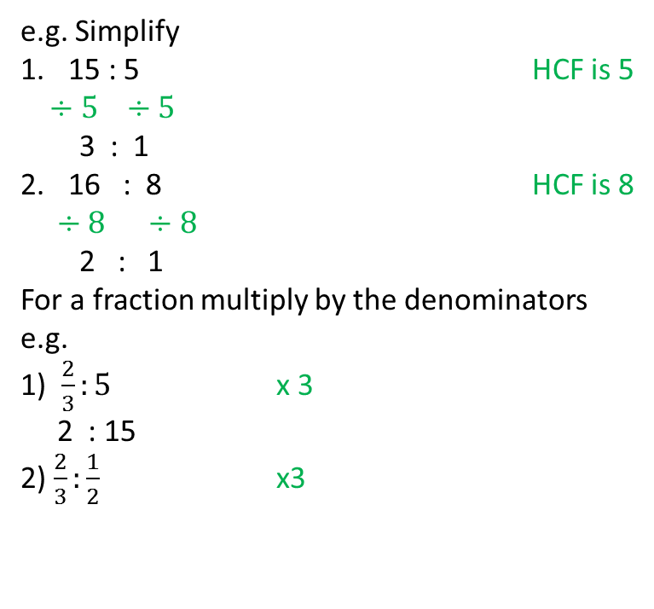
24
7
30
Date
Simplifying Ratio
EQ – How do I simplify ratios with fractions and different units
To simplify a ratio divide the values by the HCF of the values.
e.g. Simplify
15 : 5 HCF is 5
$÷5 ÷5$
3 : 1
16 : 8 HCF is 8
$÷8 ÷8$
2 : 1
For a fraction multiply by the denominators
e.g.
1) $\frac{2}{3}:5$ x 3
2 : 15
2) $\frac{2}{3}:\frac{1}{2}$ x3
11

Slide 13
24
7
30
Date
Simplifying Ratio
EQ – How do I simplify ratios with fractions and different units
To simplify a ratio divide the values by the HCF of the values.
e.g. Simplify
15 : 5 HCF is 5
$÷5 ÷5$
3 : 1
16 : 8 HCF is 8
$÷8 ÷8$
2 : 1
For a fraction multiply by the denominators
e.g.
1) $\frac{2}{3}:5$ x 3
2 : 15
2) $\frac{2}{3}:\frac{1}{2}$ x3
2: $\frac{3}{2}$ x2
4 : 3
11

Slide 14
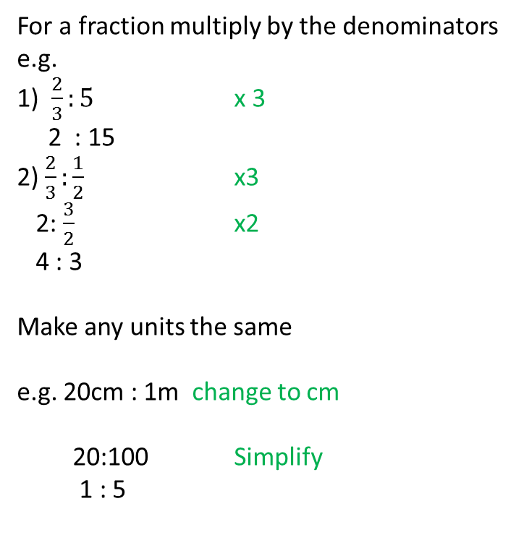
24
7
30
Date
Simplifying Ratio
EQ – How do I simplify ratios with fractions and different units
For a fraction multiply by the denominators
e.g.
1) $\frac{2}{3}:5$ x 3
2 : 15
2) $\frac{2}{3}:\frac{1}{2}$ x3
2: $\frac{3}{2}$ x2
4 : 3
Make any units the same
e.g. 20cm : 1m change to cm
20:100 Simplify
1 : 5
11

Slide 15
Notes Review
24, 7 ,30
Date
Title
Essential question
Notes complete
Notes complete with colour and diagrams
Questions completed
Contents page filed in
Formula page filled in

Slide 16
Plenary
Draw three shapes with a perimeter of 36cm.

